Slide 1
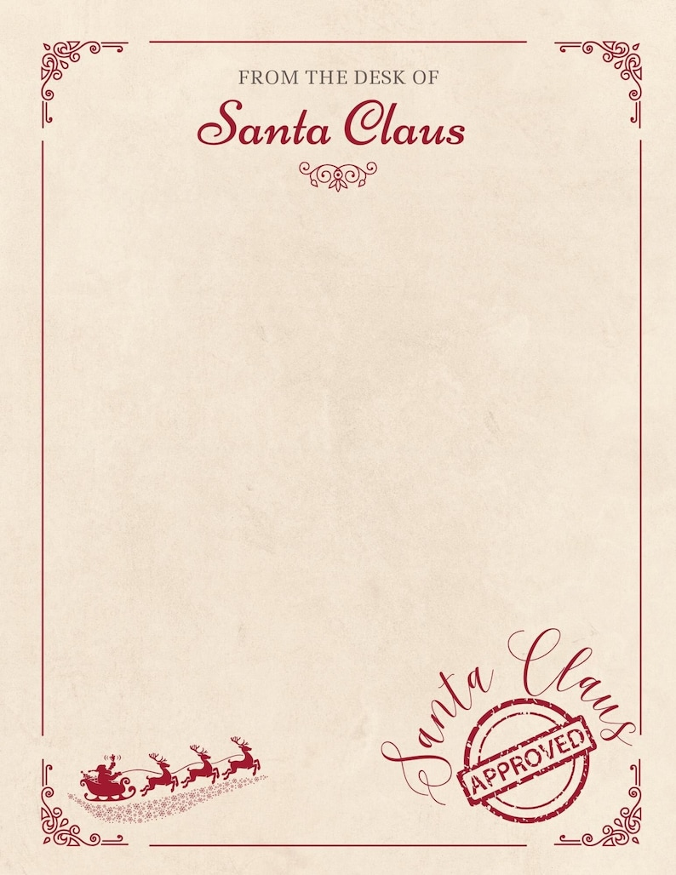
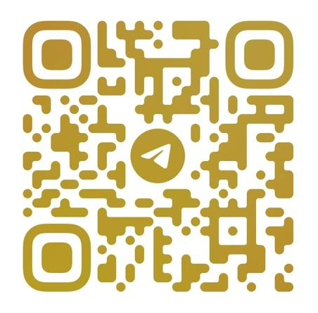
Dear Olivia,
Ho ho ho! I’ve been watching from Lapland, and wow — you two have been amazing!
Olivia, congratulations on reading your first chapter book, reaching Level 2 in ice skating, Level 3 in swimming, and climbing and singing like a star.
As a special reward… 🎁 Here’s my direct number!
Simply scan the QR with a mobile phone and you can talk to me anytime — to share questions, stories, or just say hi.
Keep up the great work!
With love and jingle bells,
Santa Claus 🎅✨

Slide 2
To Olivia

